Slide 1
Anomaly Detection Using Time-Series Foundation Models
Notes:
Limit it to 3 models

Slide 2
Predictive Maintenance (PdM)
A strategy that leverages real-time data and analytics to anticipate equipment failures before they occur
Continuously monitoring of the condition and performance
Early detection of problem to minimize unplanned downtime (repair before breakdowns)
Reducing maintenance costs (less breakdowns, minimize waste)
Improve production capacity, product quality, and overall effectiveness of the equipment
Detection of root causes
Anomaly detection, predictive failure analysis, condition monitoring, maintenance scheduling, remote monitoring and diagnostics, health indexing
Notes:
Predictive maintenance is a proactive maintenance strategy that leverages real-time data and analytics to anticipate equipment failures before they occur

Slide 3
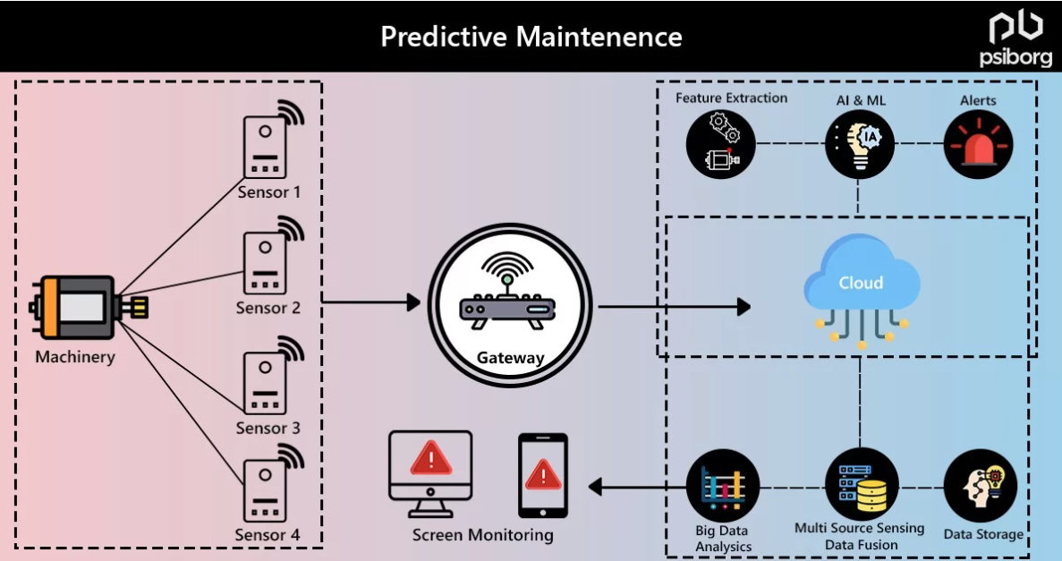
Predictive Maintenance (PdM)

Slide 4
Case Study

Slide 5






System Requirements
Environment
Multi-core CPUs with high RAM and 16Gb+ NVIDIA GPU
Fast SSD storage and suffice space for datasets, models, and artifacts (a few GBs to even TBs)
Cloud environment (AWS Sagemaker or Azure ML) if there are no on-prem resources
Software and Libraries
Python 3.8+: PyTorch, TensorFlow, HuggingFace, LangChain, LangGraph
Deployment and Scaling
Cloud (AWS/Azure/GCP)
Databases: AWS Timestream, S3, OpenSearch, PostgreSQL
CI/CD: GitHub, Sagemaker / Azure PipelinesCodePipeline, Docker/Kubernetes, Pytest, testing
Notes:
Statsmodel, pmdarima, scikit-learn, pandas, numpy, matplotlib

Slide 6
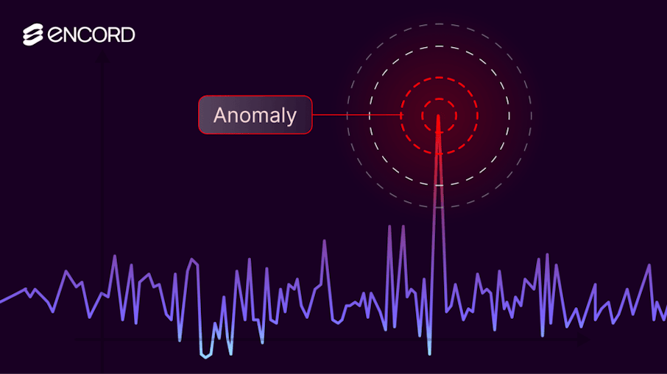

Problem Statement
Anomaly Detection
DL models: VAE, TadGan, OmniAnomaly, TranAD
Time-series FM: Chronos, TimeGPT (with classification head)
Metrics: Sensitivity, Specificity, F1, etc
Forecasting/Prediction/Predictive Modeling (Regression)
Time-series FM: Chronos, TimeGPT
Traditional models: ARIMA, Prophet, XGBoost, Linear Regression
Metrics: MAE, RMSE, coverage, reconstruction / prediction error
Calculate residual (predicted – actual), and flag anomalies if exceed threshold
Many models are open-sourced and can be found on GitHub and HuggingFace
Notes:
Coverage refers to how well the mode’s prediction intervals capture the actual observed values
Evaluates uncertainty estimation of model
Or AWS/Azure models such as Claude 3 sonnet and GPT4-o for advanced reasoning models

Slide 7
Data Collection
Time-series data from sensors / logs
Date, Time stamp
Values (vibration, temperature, pressure)
Sensor information (type, location, age, last maintenance, last fault)
Preprocess data
Handle missing values (sometimes missing values is an indicator of anomaly)
Resample to a standard sampling rate (depends on sensor devices / logs)
Segment into windows (sliding / fixed), and ways to aggregate data
Daily, Weekly, Monthly, Quarterly
Analyze if the values are correlated

Slide 8

Feature Engineering
Extract statistical features from time series
Time features:
Mean, std, kurtosis, energy
Frequency features:
Spectrum, spectrogram, MFCC, power
Domain-specific indicators:
Day of the week, month, event, type of machinery
Embeddings from autoencoders/pretrained models
More specific for ML/NN models

Slide 9


Model Selection
Models | Type | Anomaly Detection | Forecasting | Real-Time | Fine-Tuning
Chronos (Amazon) | T5 | Yes (classification/residual) | Yes | Low | Supported
TimeGPT (Nixtla) | GPT | Yes (zero shot) | Yes | Strong | Optional
PatchTST | Patch (ViT) | Yes (classification/residual) | Yes | Moderate | Required for anomaly detection
TadGAN | GAN | Yes | No | Moderate | Yes (difficult)
OmniAnomaly | VAE-GRU | Yes | No | Low | Yes
TranAD | Transformer | Yes | No | High | Yes
Notes:
Residual = Predict - Actual
ARIMA, Prophet
PatchTST use patch-based approach (overlap) to account for local/global patterns

Slide 10

Model Selection
Type | Models | Comments
LLM Integration | GPT (4, 4o, 4.5) LLaMA (3, 3.3, 4) Claude (3, 3.5, 3.7, sonnet, reasoning) DeepSeek-R1 Titan Etc | Pros Used for reasoning for time-series summaries (logs, sensor) Can generate summary for alert triage Can be combined with other models for root cause analysis Cons Need to carefully design prompt or fine-tuning approach Explanation my be inconsistent/hallucinated Slow Note Convert time-series data into textual / tokenized format Approaches: prompt engineering (COT, reasoning), LoRA/adapters/Multi-modal Fusion, RAG (time-series DB)
Notes:
“Senor readings: [1, 2, 3, 4, 5]. What is the next likely value?”
“Time: [t1, t2, t3, t4]. Values: [v1, v2, v3, v4]. Predict v5”

Slide 11
Workflow
1) Forecast / Anomaly Detection Agent
Chronos to predict future values (forecasting)
Classification head/residual for anomalies
Fine-tune using quantized tokens
2) Post processing
Convert Chronos outputs (anomaly scores, forecast errors) into structured summaries (JSON)
3) RAG
To fetch historical data, anomalies, maintenance logs, sensor documentations
Use FAISS for optimized Vector DB
4) Summarization Agent (LLaMA)
Prompt structured output into LLaMA to summarize anomalies with context
Use LoRA or QLoRA for PEFT
Or use PEFT with RAG to optimize content reasoning
Anomaly summaries, maintenance logs, alert generation
5) Notification Agent
Send alert to users, update APIs or dashboards
6) Memory and Planning Agent
Track past anomalies and actions
Plan follow-ups or escalations if pattern persist
Notes:
LlamaIndex, ChromaDB, Qdrant, Weaviate

Slide 12

Implementation (Models)
Chronos for Forecasting and Anomaly Detection
Quantize time-series into fixed vocabulary
Perform forecasting and anomaly detection via classification
Implemented via an endpoint (AWS ECS, EKS, Sagemaker, Azure AKS)
LLaMA for summarization and notification
Interpret Chronos outputs (anomalies, trends)
Generate natural language summaries
Trigger alert or notification via integration with messaging systems (agentic AI)
Implemented via an endpoint (AWS ECS, EKS, Sagemaker, Azure AKS)

Slide 13
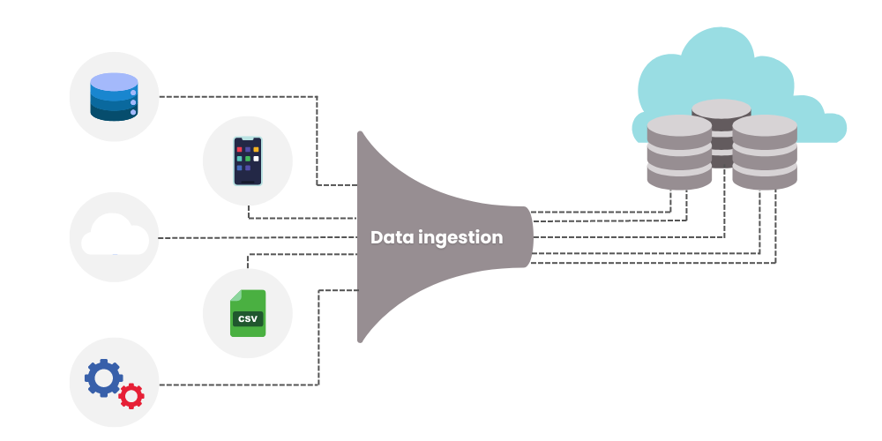
Implementation (Data and Scheduling)
Capture live data into model from a streaming architecture
AWS Kinesis, MQTT, API
Set a scheduled (cron) job
See how often do we need to check, or every time when there are new data
Daily, weekly, monthly, quarterly
Fast domain (weekly)
Slow domain (monthly)
Notes:
Message Queuing Telemetry Transport

Slide 14
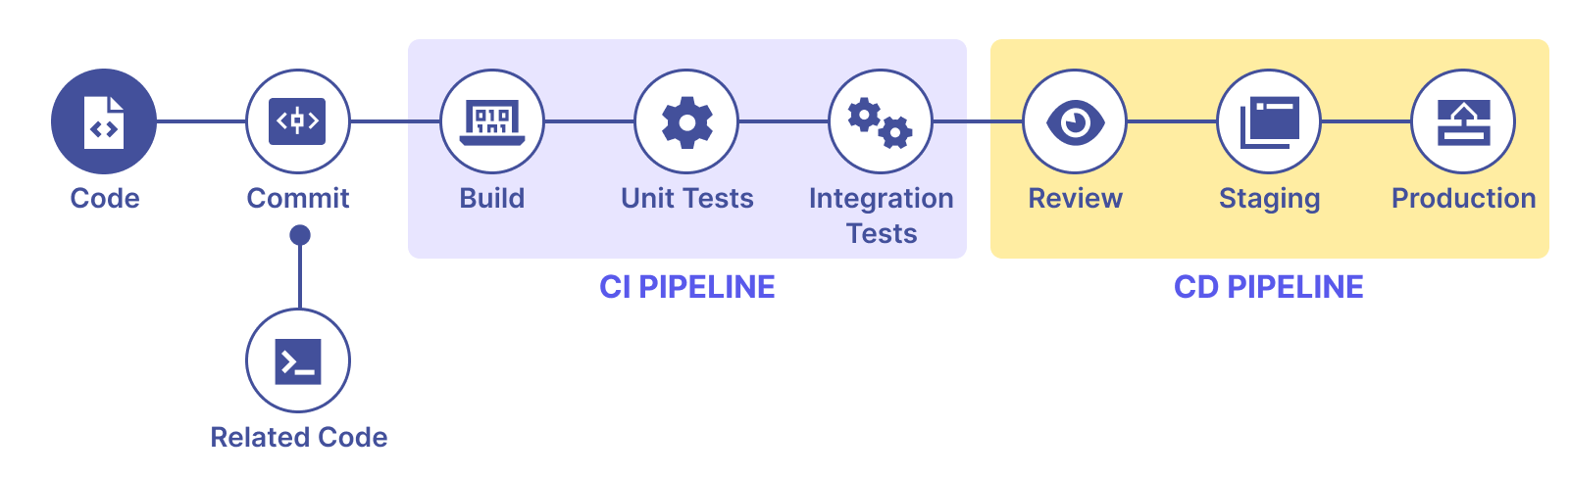
Implementation (Testing)
Perform back testing when evaluating
Utilize historic data and compare to the actual values and compute the metrics
Split historic data (train, test, validation) carefully to introduce any bias or data leakage
CI/CD pipelines (GitHub, Sagemaker/Azure Pipelines, PyTest) to trigger tests on commit/retraining
Note the condition of back testing, due to data drift
Make sure it is dynamic and always test the model on the latest data

Slide 15
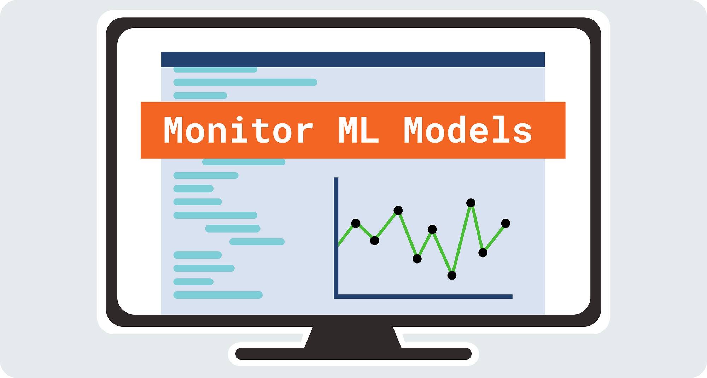
Implementation (Monitoring)
Data drift
Use KV-divergence, KS test, PSI, Jensen Shannon Divergence
Performance
Forecasting: MAE, RMSE, MAPE
Anomaly: Precision, Recall, F1-score, FPR, FNR, Anomaly rate over time
Embedding Drift (LLM/RAG)
Monitor vector similarity between new/historical embeddings, use cosine similarity for distance threshold
Set triggers for retraining (if required)
Use MLFlow to monitor and trigger retrained if needed

Slide 16
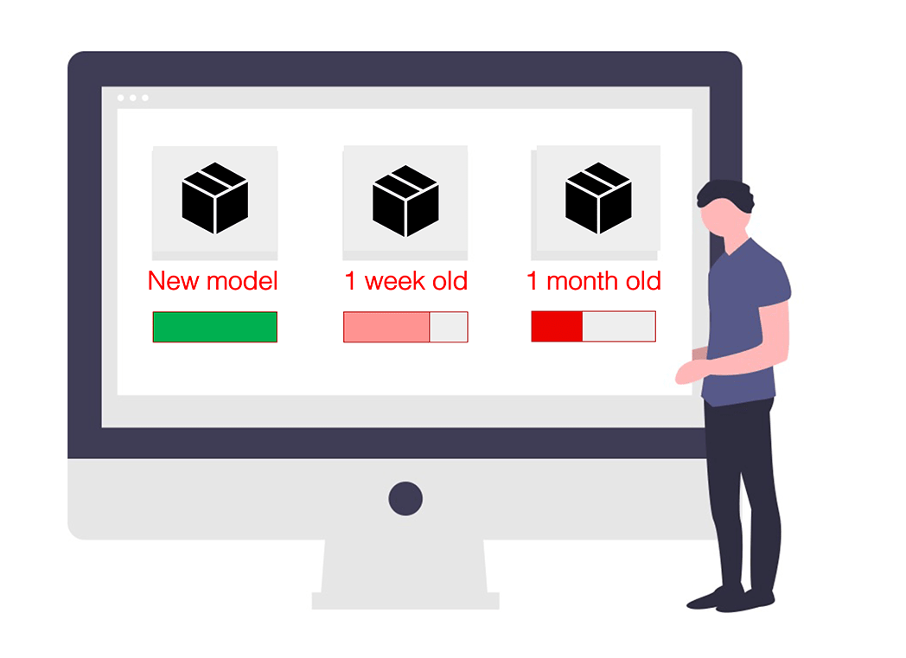
Implementation (Retraining)
Retraining Strategy (Refit model with historical + latest data)
With data drifts or performance degradation over time, retraining the model with the latest data is important
Continuously check model drift and performance degradation
Schedule retraining (daily, weekly, depending on volatility), or when data drift is detected
If back testing metrics degrade past threshold, start retraining
Store new models in versioned form for rollback capabilities (AWS S3, MLFlow, HuggingFace, etc)

Slide 17

Summary
Chronos forecast and detect anomalies
Anomaly meta data is stored in vector DB (FAISS)
LLaMA queries the vector DB via RAG to get similar past events
LLaMA generates a summary and recommendation based on situation
Agent send notification as required

Slide 18
Challenges
Challenges | Details
Data quality and availability | - Missing or irregular data from sensors/logs, and limited history - Noisy, spikes, structure shift, anomalies
Non-Stationary and Concept Drift | - Distribution shift over time break models assumption (stationary) and degrade performance - Detecting drift and adapting pipeline dynamically is non-trival
Overfitting | - Models can fit noise and peculiarities of training data, especially when datasets are small
Model Selection | - Choosing between statistical, ML, transformer, foundation models are difficult as each has their benefits
Standard CV fails | - Temporal leak, non-stationarity bias, requires careful back testing, which are hard to maintain/automate
Explainability | - Deep learning models are “black boxes”, making it hard to trace predictions and gain trust
Implementation | - Building a deep complex pipeline for training and inference is difficult - Online data is different from offline data
Resources Constrains | - Deep learning models need a lot of compute, increasing training cost (if frequently) - Sensor data take up a lot of storage
Unpredictability | - Predictive model extrapolate from past patterns, but fail when there are new events or regime shift - Overreliance without contingency planning (scenario analysis, rule based) can be very dangerous
Notes:
And hard to get people to adopt

Slide 19
Limitations
Limitations | Details
Lack of data | Some machineries do not have sensors, and requires installation of sensors No historic data to work with
Data quality and consistency | Poor data quality due to noise, missing values, inconsistencies Can lead to inaccurate prediction and maintenance inefficiencies
Infrastructure and scalability | Network bandwidth, data latency, computational power challenges
Model accuracy and maintenance | Must be able to capture complex patterns across diverse equipment and conditions Model drift due to changes in operation patterns pose ongoing challenges
Change management | Teams are hesitant to adopt AI, perceiving it as a threat or are skeptical of its reliability
Integration with legacy systems | Outdated technologies and limited interoperability, not compatible with modern AI solutions, restrict data flow

Slide 20
Thank you

Slide 21
Appendix

Slide 22
Introduction to Predictive Maintenance

Slide 23
Predictive Maintenance (PdM)
Predictive maintenance is a proactive maintenance strategy that leverages real-time data and analytics to anticipate equipment failures before they occur
Continuously monitoring of the condition and performance
Early detection of problem to minimize unplanned downtime (repair before breakdowns)
Reducing maintenance costs (less breakdowns, minimize waste)
Improve production capacity, product quality, and overall effectiveness of the equipment
Detection of root causes
Anomaly detection, predictive failure analysis, condition monitoring, maintenance scheduling, remote monitoring and diagnostics, health indexing

Slide 24
Predictive Maintenance (PdM)

Slide 25
Predictive vs Preventive
Predictive | Preventive
Actual Mean Time To Failure (MTTF) is the results of data analysis directly on the field | Estimation of MTTF
Data driven decision method | Decisions must be taken according to experience/intuition
Activities are scheduled when needed | Job is done also when not needed, increasing risk of infant mortality

Slide 26



Key Components
Key Components
Sensor Data Collection: Utilize IoT sensors to gather real-time data
Vibration, temperature, pressure, etc
Data Analysis
Use algorithms and predictive analytics to analyze and identifying patterns that indicate potential failures
Anomaly detection, regression models
Maintenance Scheduling
Perform maintenance precisely when needed, avoid unnecessary routine checks and preventing unexpected breakdowns

Slide 27
Workflow
Workflow
Data Acquisition
Sensors installed on equipment collect continuous data during normal operations
Data Processing
Collected data is transmitted to a centralized system where it is processed and analyzed
Anomaly Detection
Algorithms detect deviations from normal operating conditions, signaling potential issues
Predictive Modeling
Models predict Remaining Useful Life (RUL) of components, estimating when maintenance should be performed
Actionable Insights
System provides maintenance team with insights and recommendation to allow timely interentions

Slide 28
Techniques
Techniques | Details
Vibration | Machinery, rotating machines, structural (1-10kHz)
Thermography and Tribology | Temperature, thermal anomaly, infrared radiation, only emitted energy is important here Lubricating oil, spectrographic, ferrography, wear particle
Ultrasonic Monitoring | Similar to vibrations, to detect higher frequency (20kHz – 100Hz) Leak detection, structure Operating dynamic analysis, acoustic emission, eddy current, magnetic particle, residual stress
Electric Motor | Insulation resistance analysis, dielectric loss analysis, gas in oil analysis, stray field analysis, high voltage switchgear discharge test, resistance measurements, rotor bar current harmonics
Process Parameters Visual Inspection | Efficiency parameters, fluid (dynamic head, etc), heat exchangers, pumps, filters, boilers, fans Need to install gauges and sensors to get information, or do it manually Procedures, inspection program and schedules, check lists, report what is seen
Notes:
Ferrography

Slide 29
Benefits
Cost | Benefits
Initial capital cost (design, installation, validation, materials) | Reduce breakdown and downtime
Recurring cost (labour, training, calibration, renting, outsourcing) | Reduce unnecessary maintenance; cost efficiency
Overall, it can be very expensive It must not exceed with predictive maintained, there is an optimal point that leads to failure in strategy | Enhanced safety as machinery may be damaged and catch fire/explode
 | Focus maintenance on key issues, hence optimizing resources utilization

Slide 30
Data Acquisition Frequency and Parameters
Steps | Details
Preliminary Dataset baseline | Machine and equipment list creation Database accuracy verification Multiple initial data acquisition for initial trending
Data acquisition frequency | Continuous, 2–3-week, 3–4-week, 4–6-week, 6–10 week Use linear optimization model to calculate maximum frequency Some specific sensors requires a set frequency for maintenance At least quarterly
Analysis parameters | Calculated values from raw data (thermal profiles, etc) Machine details, classification, last maintenance, etc

Slide 31
Signature boundaries, alert, and alarm limits
Type | Details
Signature analysis boundaries | Important to capture the correct amount of data with the correct resolution If Fmax = 1000Hz (any frequency above that is not detected) Resolution = 400 Hz (2.5Hz gaps)
Alert and Alarm Limits | Severity charts, ISO Standards (maximum limits) System powered by AI, analysis tools, S.C.A.D.A

Slide 32
Limitations
Limitations | Details
Lack of data | Some machineries do not have sensors, and requires installation of sensors No historic data to work with
Data quality and consistency | Poor data quality due to noise, missing values, inconsistencies Can lead to inaccurate prediction and maintenance inefficiencies
Infrastructure and scalability | Network bandwidth, data latency, computational power challenges
Model accuracy and maintenance | Must be able to capture complex patterns across diverse equipment and conditions Model drift due to changes in operation patterns pose ongoing challenges
Change management | Teams are hesitant to adopt AI, perceiving it as a threat or are skeptical of its reliability
Integration with legacy systems | Outdated technologies and limited interoperability, not compatible with modern AI solutions, restrict data flow

